Slide 1

KING STARTM HEATING & AIR
Squaring the Circle to Demand-Side Efficiency with the King StarTM ‘Upper 90’
Maintenance Agreement
Notes:
Getting kicks –, Squaring the Circle –, Upper 90

Slide 2
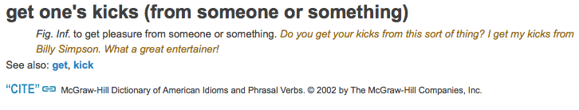
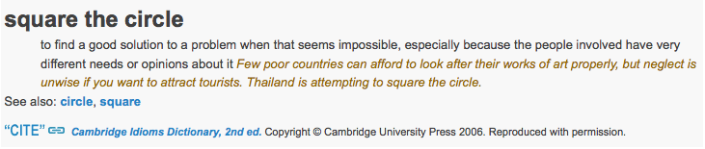
intercept idioms: getting kicks & square the circle
Notes:
Cambridge University Press

Slide 3
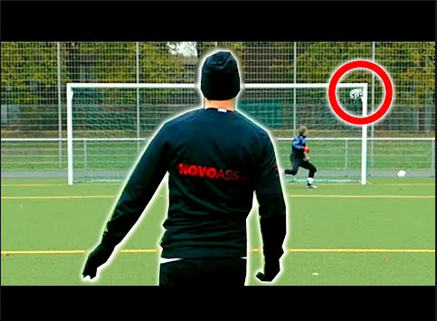
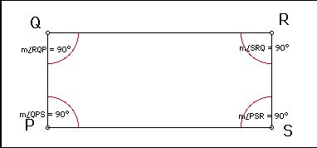
Intercept Idiom: ‘upper 90’—is a term kommonly used in ‘The Beautiful Game’ to describe the top left or right portion of the goal. Because the 4-sided, quadrilateral goal is rectangular, there are 4x90° angles (or squares) in each corner—two upper 90° (between the crossbar and L & R goal posts), and two lower 90° (between the ground—or pitch—and L & R goal posts).
Notes:
Kommonly – solecism, The Beautiful Game, quadrilateral, pitch

Slide 4
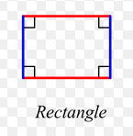
intercept idiom: ‘last gasp goal’—is a term kommonly used in ‘The Beautiful Game’ to describe a goal made in the last few moments of a match. The literal meaning of ‘last gasp goal’ is to take one’s last breath before ‘the last roundup’.
Notes:
Kommonly – solecism, The Beautiful Game, quadrilateral, pitch

Slide 5
intercept idiom: ‘slotted a quad’—a King Star-coined idiom for ‘The Beautiful Game’ that describes a goal shot into one of the 4x90° quadrilateral squares. The literal meaning of ‘slotting a quad’ is putting a quarter in a vending machine.
Notes:
Kommonly – solecism, The Beautiful Game, quadrilateral, pitch

Slide 6
‘Getting his kicks in the upper 90’, the attacker ‘squares the circle’ by ‘slotting a quad’ on a ‘last gasp goal’!
Purple-conscious, intercepted call-to-action: donate quarters to a favorite youth soccer club, homeless shelter—or look at 2 million Syrian immigrants surging on their ‘last gasp goal’ to Europe.

Slide 7
Solecisms—Intentional incorrectness—now in effect-ness, let’s rotate the red-squared circle kounter-klockwise…
Notes:
Kommonly – solecism, The Beautiful Game, quadrilateral, pitch

Slide 8
Here it komes’…

Slide 9
Keeper’
Komin’

Slide 10
Right angle is
Now vectored
For the top-k’

Slide 11

Let’s change fokus to max the objective top-k’ view...

Slide 12

Here it komes’…

Slide 13
Here it komes’…

Slide 14
Here it komes’…

Slide 15
Vortexing the rotated right angle results in…

Slide 16
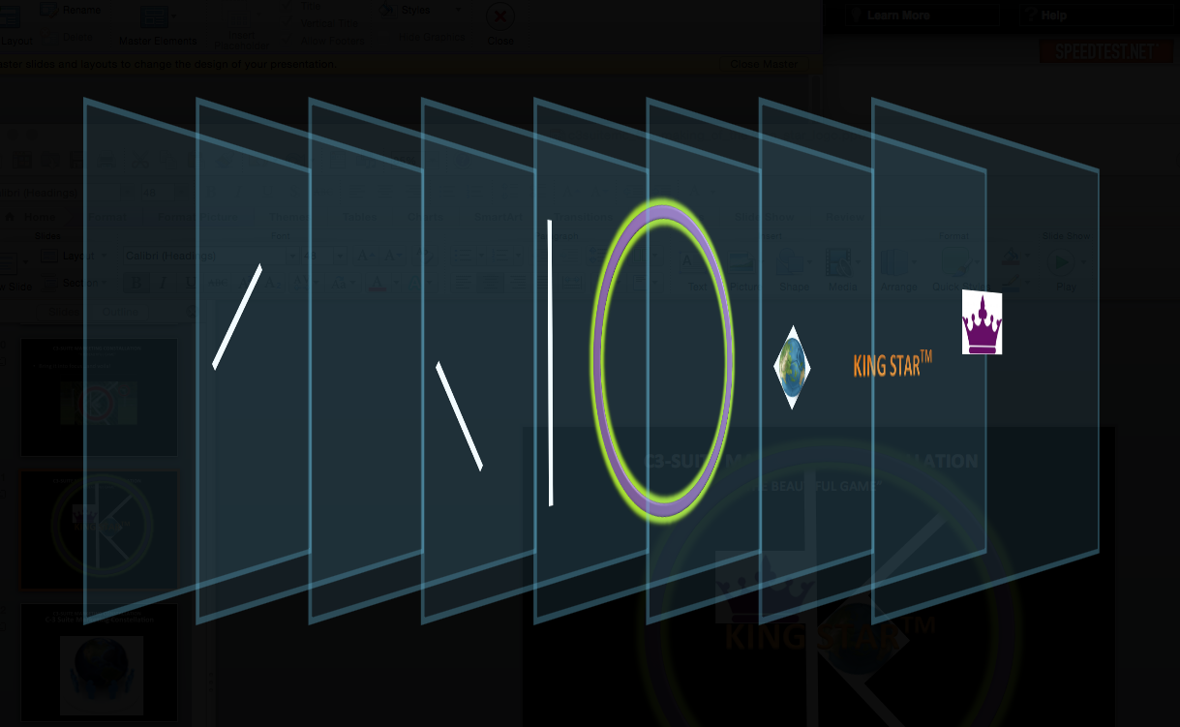
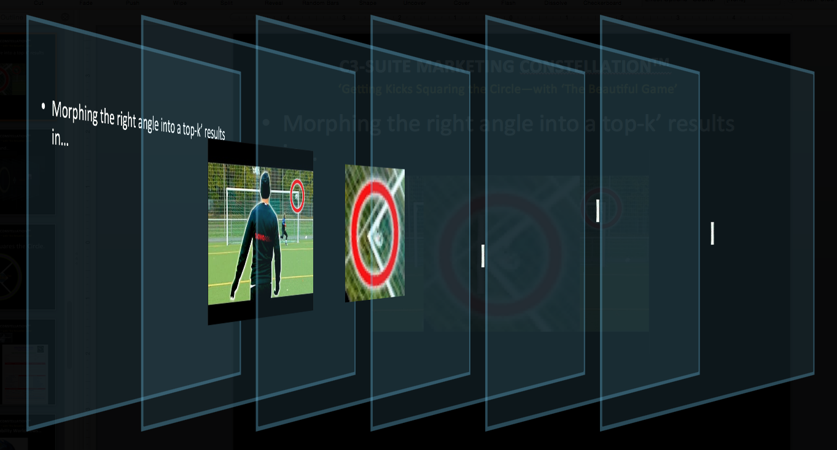
re-ordering objects and…
Notes:
King Star Logo Description: Eco-green colored upper left or right goal post rotated counter-clockwise with right angle touch a same-colored vertical goal post forming the letter “k” inside the perimeter of a purple circle. A globe-type football is positioned inside the right anglel

Slide 17
re-ordering again…
Notes:
King Star Logo Description: Eco-green colored upper left or right goal post rotated counter-clockwise with right angle touch a same-colored vertical goal post forming the letter “k” inside the perimeter of a purple circle. A globe-type football is positioned inside the right anglel

Slide 18

Voila! King Star Squares the Circle

Slide 19

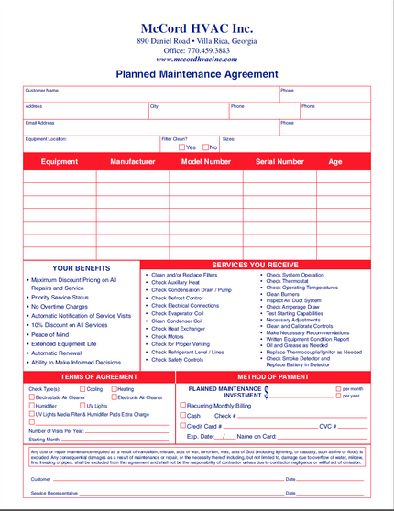

KING STARTM is a veteran-owned, NATE-certified small business with 30-yrs experience ‘getting its kicks’ helping clients ‘square the circle’ to satisfy demand-side indoor air quality (IAQ) needs of Metro Denver residents. Call (720) 410-3755 when you need to combat energy waste and lower your energy bill by receiving affordable service with our Green ‘Upper 90’ Maintenance Agreement.

Slide 20

Expanding Worldviews…

Slide 21
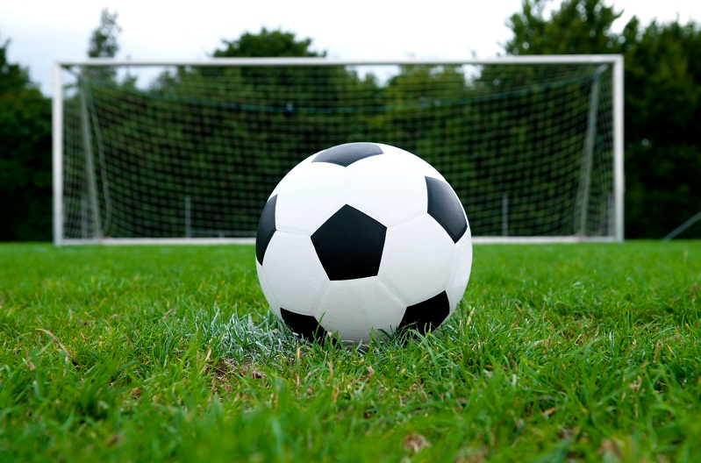
with ‘The Beautiful Game’.

Slide 22




…so loved ‘The Beautiful Game’.

Slide 23
…so loved ‘The Beautiful Game’.

Slide 24


With the ‘Beautiful Game’
LinkedIn’s One-Bounce OSINT
Niche on the Pitch Marketer

